Slide 1
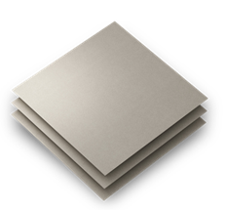
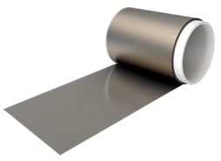
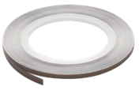
NOISE SUPPRESSION SHEET, ROLL OR TAPE
FLEX SUPPRESSOR®
Overview
Electrical Characteristics
KEMET Noise Suppression Sheet
FLEX SUPPRESSOR ® is effectively designed for high frequency noise that is generated from electronic devices. The flexible sheet is a polymer base, blended with micron-sized magnetic powders dispersed throughout the material. These sheets are effective for electromagnetic wave and resonance suppression and can be cut into a variety of shapes and sizes.
Permeability range from 25 to 250
Operating temperature from –40°C to 105°C (FF1 & EFF4 125°C)
Operating frequency from 1 MHz to 40 GHz
Attenuation Characteristics
Features
@ 700 MHz
(1 MHz-3 GHz)
RoHS compliant
1 MΩ/sq. typical surface resistivity
UL file N° E176124
Part Number System
(01)-
@ 2.4 GHz
(1 GHz-10 GHz)
EFF4
240X240
T0800
Adhesive Thickness Code
Blank = No adhesive
T0800 = 0.003 mm
T2900 = 0.01 mm
@10 GHz
(3 GHz-40 GHz)
Size Code
240X240 = 240 mm X 240 mm sheet
240X80 = 240 mm X 80 mm sheet
240X10M = 240 mm X 10 M roll
5X50M = 5 mm X 50 M tape
Applications
Thickness Code
01 = 0.1 mm
03 = 0.3 mm
10 = 1.0 mm
25 = 0.025 mm
50 = 0.05 mm
100 = 0.1 mm
Suitable for noise-sensitive applications including:
Consumer electronics
Telecommunications devices
Automotive infotainment
LTE / Wi-Fi
LTE / Wi-Fi / 5G
FM / DVB / GPS / Wi-Fi
Series
View FLEX SUPPRESSOR® here
© KEMET Corporation. All Rights Reserved.
Refer to KEMET datasheets for full details

